Slide 1
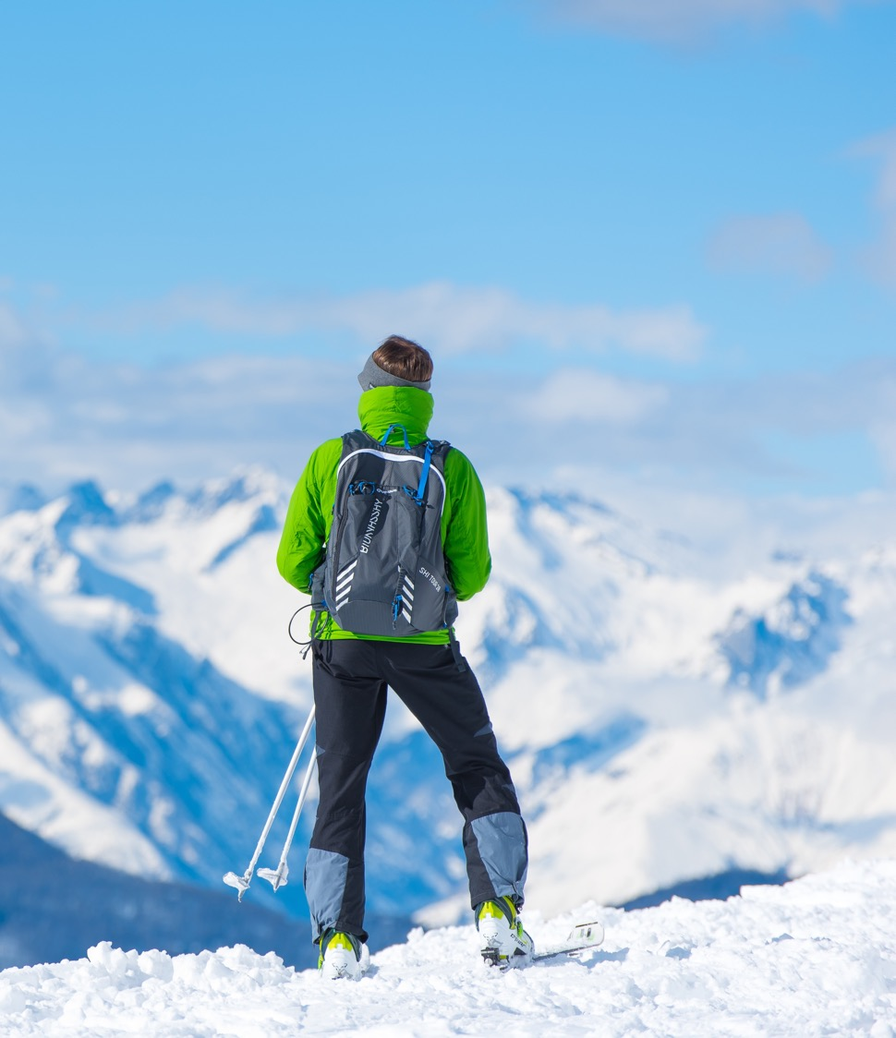
Big Mountain Resort
Guided Capstone Project Presentation

Slide 2
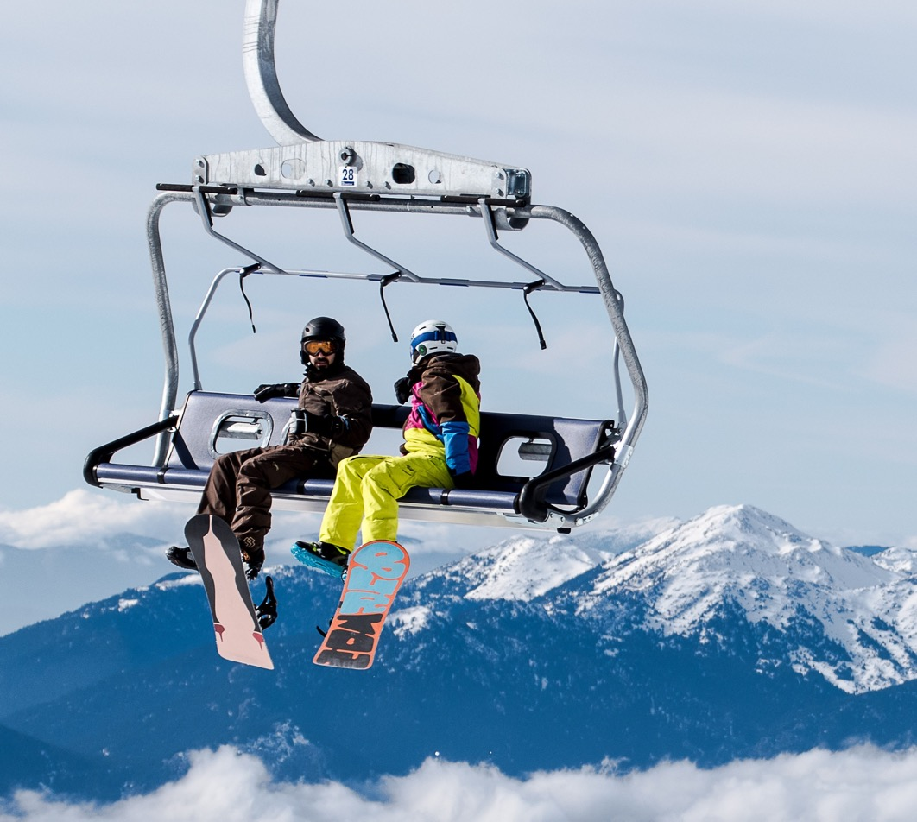
Large Image slide
Content:
Problem identification
Recommendation and key findings (1 slide)
Modeling results and analysis (3-4 slides)
Summary and conclusion (1 slide)
Notes:
© Copyright Showeet.com – Free PowerPoint Templates

Slide 3
Large Image slide
Problem Statement Worksheet (Hypothesis Formation)
Figure out how much the business should cut costs without undermining the ticket price, and/or compare the ticket price to market price to determine how much the ticket price should increase in next season.
H
1
Context
4
Constraints within solution space
Big Mountain Resort, a ski resort located in Montana, installed an additional chair lift which cause a operating cost increase of $1,540,000.
The business wants some guidance on how to select a better value for their ticket price.
1. Big Mountain is not capitalizing on its facilities as much as it could.
2. Basing their pricing on just the market average does not provide the business with a good sense of how important some facilities are compared to others.
2
Criteria for success
5
Stakeholders to provide key insight
1. Get the accurate number of changes if the business decides to cut costs.
2. Calculate the changes of price if the business should increase the ticket price.
3. Find out which plan is better for the business.
Director of Operations - Jimmy Blackburn
Database Manager - Alesha Eisen
3
Scope of solution space
6
Key data sources
Operating cost reduction plan will be specifically applied at chair lift and other underutilized facilities.
A single CSV file that you got from the database manager
SQL database
S3 bucket
Notes:
© Copyright Showeet.com – Free PowerPoint Templates

Slide 4
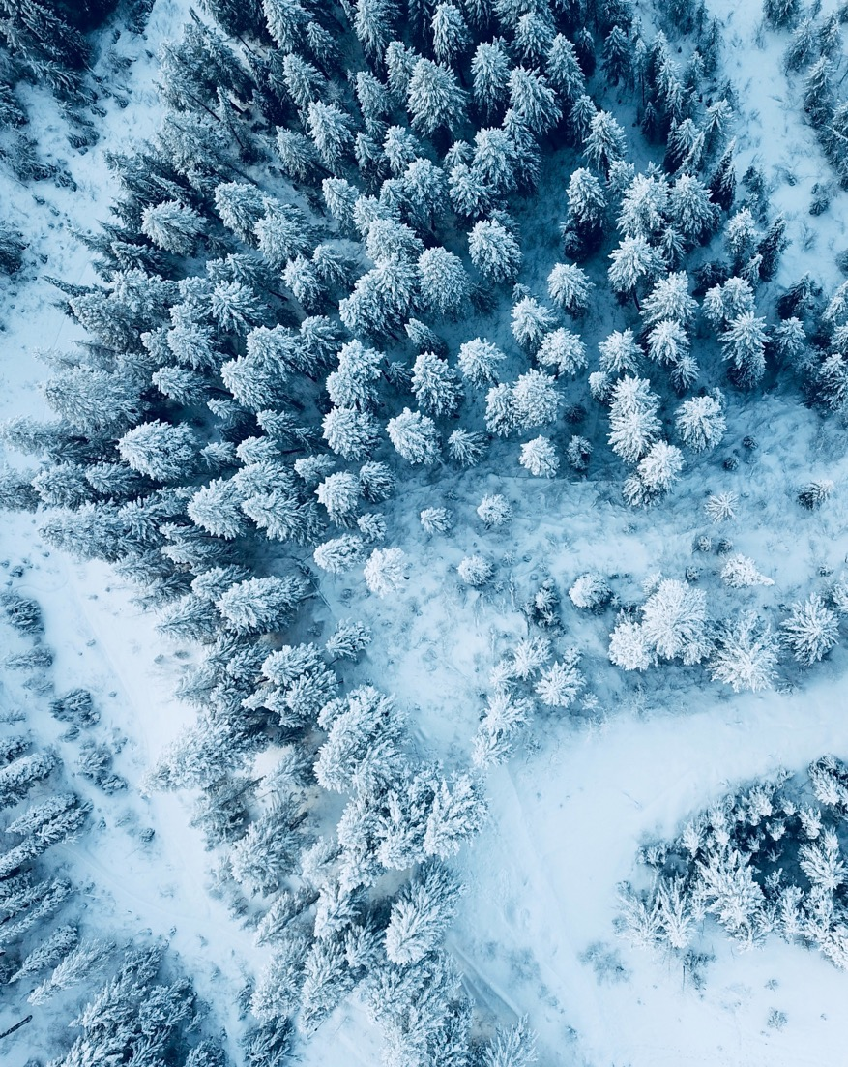
Large Image slide
Data Science Problem:
Our business problem was a general one of modeling resort revenue, and the data science problem is to predict the adult weekend ticket price for ski resorts.
Notes:
© Copyright Showeet.com – Free PowerPoint Templates

Slide 5
Large Image slide
Key Findings:
1. Missing Value: Some of columns have missing value, over 50% of values in fastEight column are missing. We’re also missing nearly 16% of the price value. Weekday price is missing in a few more records than weekend price. So we decided to use weekend price to build the following models.
2. After drew PCA on the dataset, we decided to treat all state equally, and work towards building a pricing model that considers all states together.
3. We visualized the ratio of resort skiable area to total state skiable area, ratio of resort days open to total state days open, ratio of resort terrain park count to total state terrain park count, and ratio of resort night skiing area to total state night skiing area with scatter plots, but found out a counterintuitive results. It seems that more chairs a resort has, the lower the ticket price is. This is because of the exclusive vs. mass market resort effect.
Notes:
© Copyright Showeet.com – Free PowerPoint Templates

Slide 6
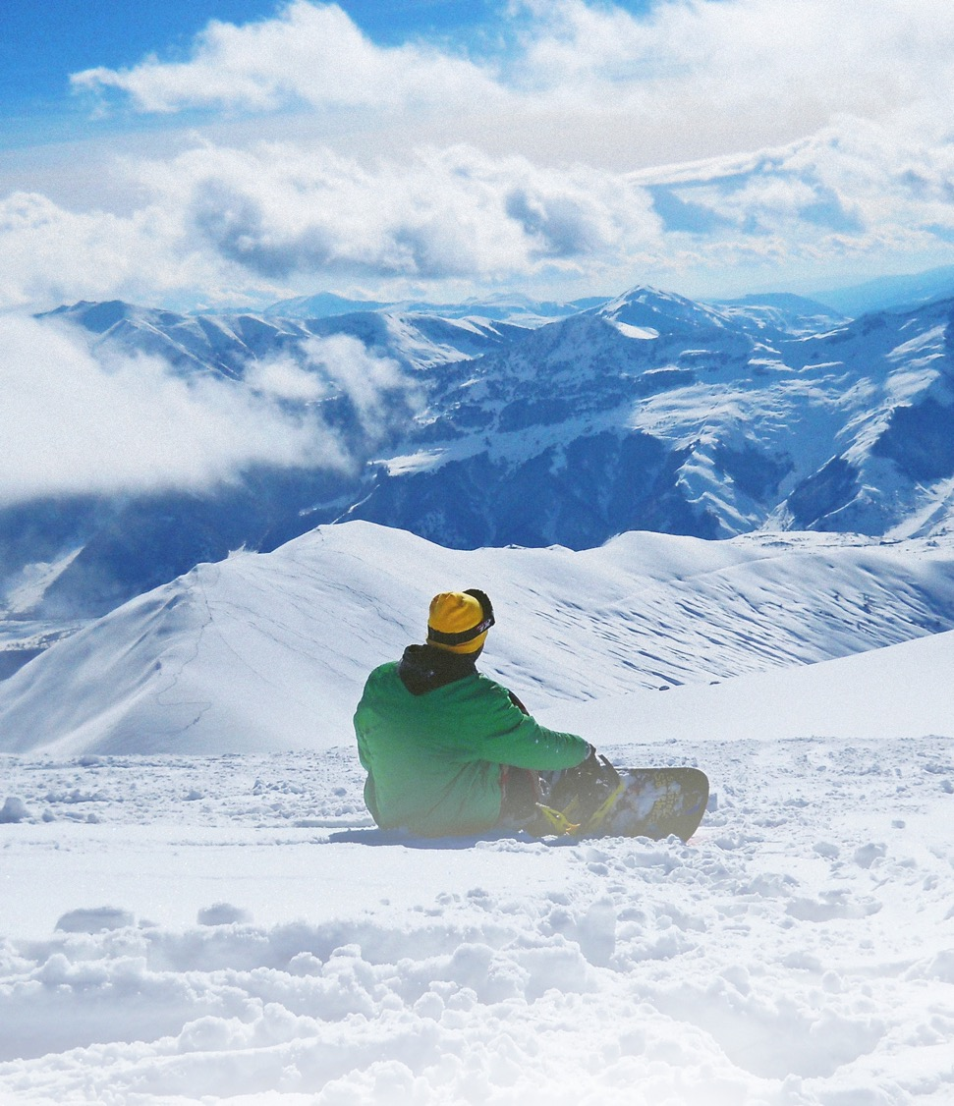
Large Image slide
Modeling: Linear Regression vs. Random Forest
Using Linear Regression model, on average, we are expected to estimate the ticket price within $11 or so of the real price.
Using Random Forest model, Using this model, on average, we are expected to estimate the ticket price within $9 or so of the real price.
Since the Random forest model has lower cross-validation mean absolute error, we picked random forest model instead of linear regression model.
Notes:
© Copyright Showeet.com – Free PowerPoint Templates

Slide 7
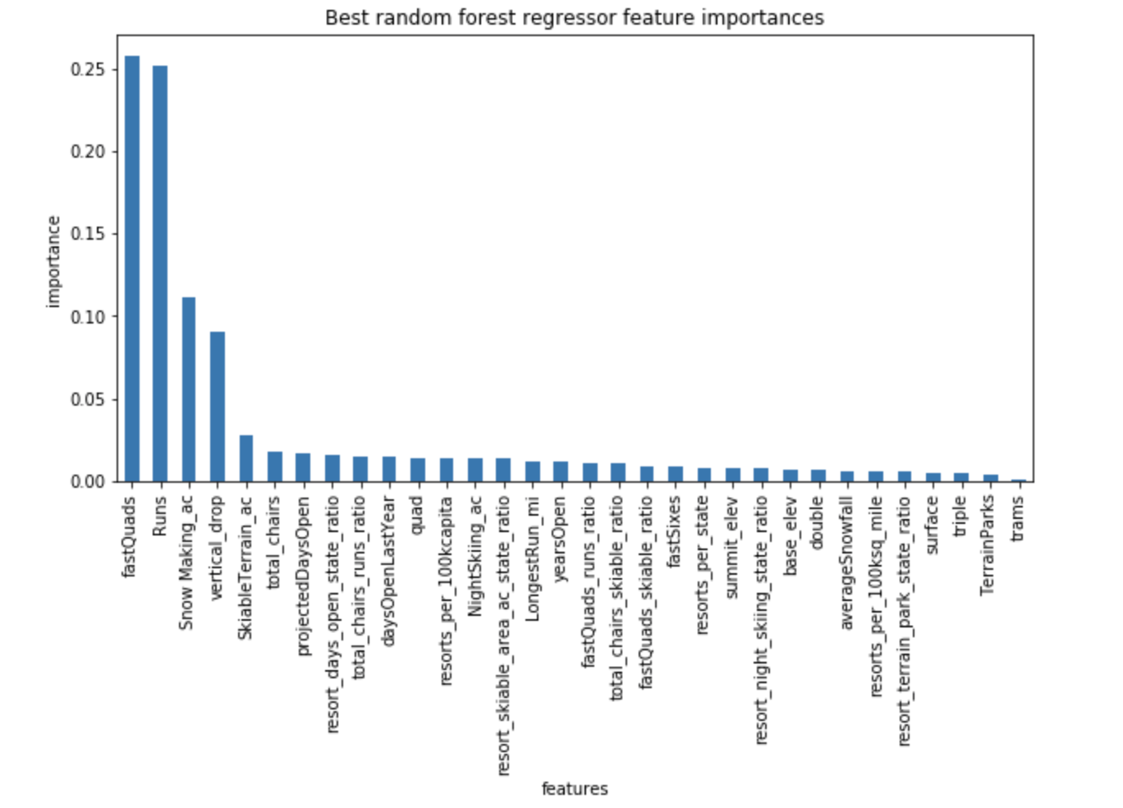
Large Image slide
Modeling: Random Forest Key Features
Top Four Features:
fastQuads
Runs
Snow Making_ac
vertical_drop
Notes:
© Copyright Showeet.com – Free PowerPoint Templates

Slide 8
Large Image slide
Modeling: data quantity assessment
there is an initial rapid improvement in model scores, but it’s essentially levelled off by around a sample size of 40-50.
Notes:
© Copyright Showeet.com – Free PowerPoint Templates

Slide 9
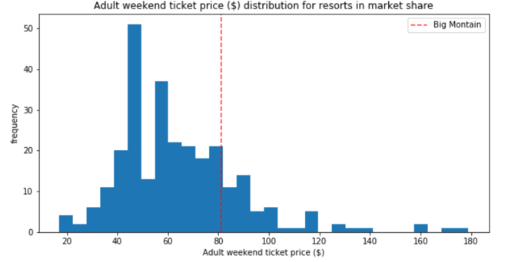
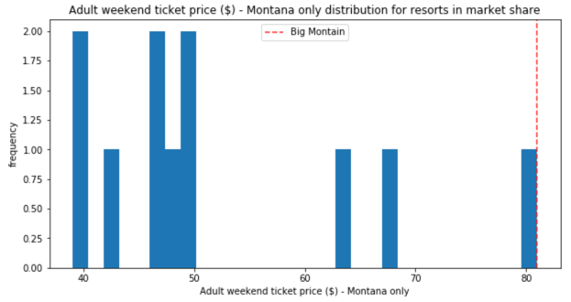
Large Image slide
Analysis: Big Mountain Resort (BMR) in Market Context
The following features come up as necessary in the modeling:
The vertical drop in BMR is 2353ft, which is doing well compared to other resorts, but there are still quite a few resorts with a more significant drop.
Big Mountain is very high up the snow-making area's league table and has amongst the highest number of total chairs, regardless of the outlier.
Most resorts have no fast quads. Big Mountain has 3, which puts it high up that league table.
It also compares well for the number of runs. Big Mountain has one of the longest runs.
Although it is just over half the length of the longest, the longer ones are rare.
Big Mountain is amongst the resorts with the largest amount of skiable terrain.
Notes:
© Copyright Showeet.com – Free PowerPoint Templates

Slide 10
Large Image slide
Analysis: Modeling Scenarios
Scenario1: Close up to 10 of the least used runs.
The model shows closing one run will not affect the revenue. The revenue will decrease by $2,250,000 if they close 6 to 8 runs and be reduced by $3,000,000 if they close 9 to 10 runs.
Scenario2: Adding a run, increasing the vertical drop by 150 feet, and installing an additional chair lift.
By adding these extra supports, the ticket price increase by $1.99, which equivalent to an annual revenue increase of $3,474,638. This amount can easily cover the operating cost of installing an additional chair lift. If we keep the original conditions in scenario two but add 2 acres of snow-making, the result makes no difference.
Scenario3: calls for increasing the longest run by .2 miles and guaranteeing its snow coverage by adding 4 acres of snow-making capability.
This scenario doesn't change the ticket price and annual revenue at all.
Notes:
© Copyright Showeet.com – Free PowerPoint Templates

Slide 11
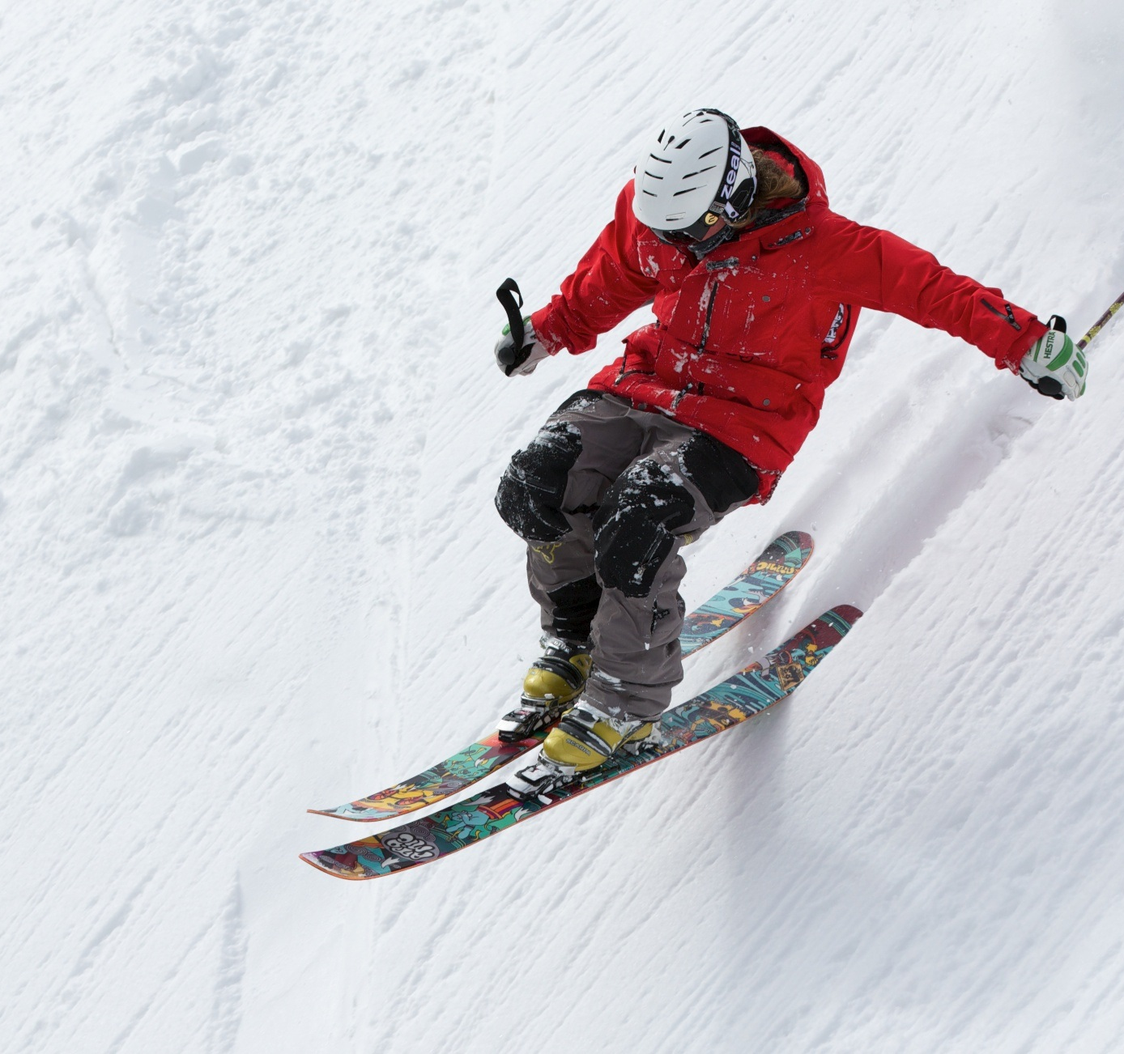
Large Image slide
Conclusion:
Big Mountain Resort Price is $94.22, but the actual price is $81. Even with the expected mean absolute error of $10.39, this suggest there is room for an increase, the resort is undercharging.
The additional operating cost can be easily covered if we choose Scenario.
Notes:
© Copyright Showeet.com – Free PowerPoint Templates

Slide 12
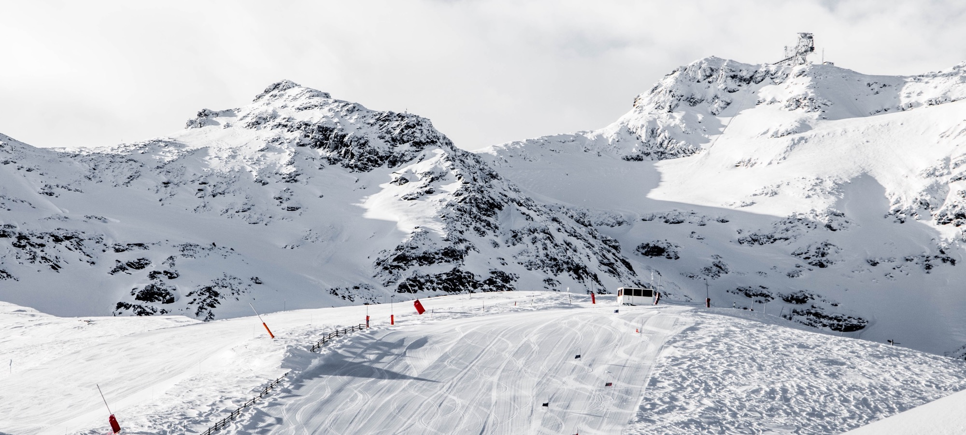
Large Image slide
Thank you!
Notes:
© Copyright Showeet.com – Free PowerPoint Templates

